Slide 1
MapReduce
Notes:
https://www.junaideffendi.com/p/everything-you-need-to-know-about https://www.youtube.com/watch?v=9e3geIYFOF4&list=PLBv09BD7ez_6b7342XmYBMzPXwJ2YAWRN&index=6 - PageRank

Slide 2
Outline
A bit about Distributed Systems
MapReduce Overview
MapReduce in Industry
Programming Hadoop MapReduce Jobs
Mappers and Reducers
Operating Model

Slide 3
Outline
A bit about Distributed Systems
MapReduce Overview
MapReduce in Industry
Programming Hadoop MapReduce Jobs
Mappers and Reducers
Operating Model

Slide 4
Our Primary Concerns:
Running computation on large amounts of data
Want a Framework that scales from 10GB => 10TB => 10PB
High throughput data processing
Not only processing lots of data, but doing so in a reasonable timeframe
Cost efficiency in data processing
Workloads typically run weekly/daily/hourly (not one-off)
Need to be mindful of costs (hardware or otherwise)

Slide 5
What traditionally restricts performance?
Processor frequency (Computation-intensive tasks)
Fastest commodity processor runs at 3.7 - 4.0 Ghz
Rough correlation with instruction throughput
Network/Disk bandwidth (Data-intensive tasks)
Often, data processing is computationally simple
Jobs become bottlenecked by network performance, instead of computational resources

Slide 6
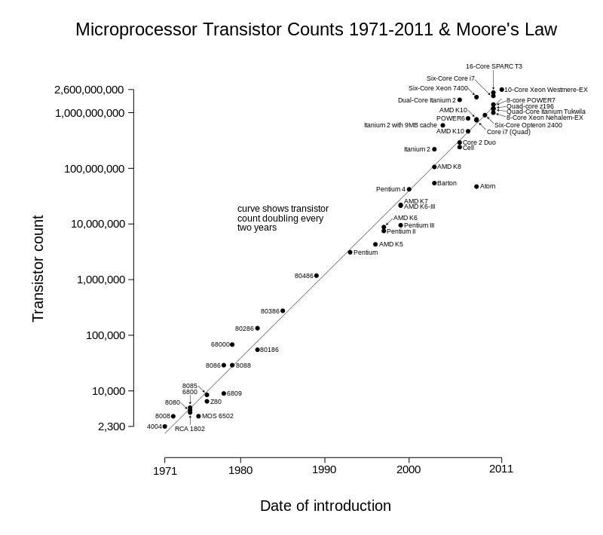
Moore’s Law
The number of transistors in a dense integrated circuit doubles approximately every two years
It’s failing!

Slide 7
Parallelism
If Moore’s law is slowing down how can we process more data at local scale?
More CPU cores per processor
More efficient multithreading / multiprocessing
However, there are limits to local parallelism…
Physical limits: CPU heat distribution, processor complexity
Pragmatic limits: Price per processor, what if the workload isn’t CPU limited?

Slide 8
Distributed Systems from a Cloud Perspective
Mindset shift from vertical scaling to horizontal scaling
Don’t increase performance of each computer
Instead, use a pool of computers - (a datacenter, “the cloud”)
Increase performance by adding new computer to pool
(Or, buy purchasing more resources from a cloud vendor)

Slide 9
Distributed Systems from a Cloud Perspective
Vertical Scaling - “The old way”
Need more processing power?
Add more CPU cores to your existing machines
Need more memory?
Add more physical memory to your existing machines
Need more network bandwidth?
Buy/install more expensive networking equipment

Slide 10
Distributed Systems from a Cloud Perspective
Horizontal Scaling
Standardize on commodity hardware
Still server-grade, but before diminishing returns kicks in
Need more CPUs / Memory / Bandwidth?
Add more (similarly spec’d) machines to your total resource pool
Still need to invest in good core infrastructure (machine interconnection)
However, commercial clouds are willing to do this work for you
Empirically, horizontal scaling works really well if done right:
This is how Google, Facebook, Amazon, Twitter, et al. achieve high performance
Also changes how we write code
We can no longer consider our code to only run sequentially on one computer

Slide 11
Outline
A bit about Distributed Systems
MapReduce Overview
MapReduce in Industry
Programming Hadoop MapReduce Jobs
Mappers and Reducers
Operating Model

Slide 12
Motivation
Motivation
Large amount of raw data to process
Conceptually straightforward computation
Distributed computations → Finish in reasonable time
Problems:
Parallelize computations
Distribute data
Handle failures

Slide 13
MapReduce
What it is:
A programming paradigm/model to break data processing jobs into distinct stages which can be run in a distributed setting
Big Idea:
Restrict programming model to get parallelism “for free”
Most large-scale data processing is free of “data dependencies”
Results of processing one piece of data not tightly coupled with results of processing another piece of data
Increase throughput by distributing chunks of the input dataset to different machines, so the job can execute in parallel

Slide 14
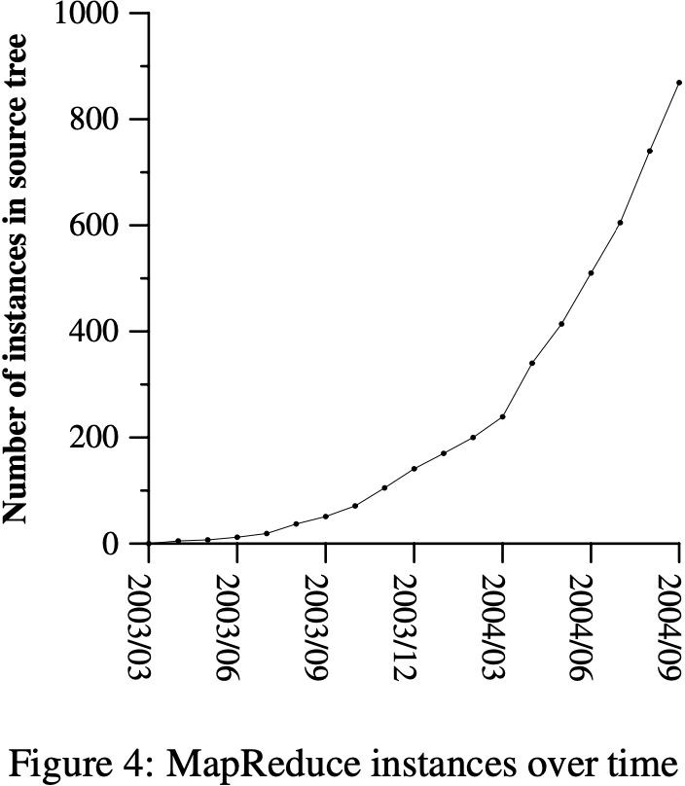
MapReduce: Overview
MapReduce: Overview
First version in 2003 by Google
Significant growth of usage
Applications:
Large-scale machine learning problems
Clustering problems for the Google News
Extraction of data in queries &
Extraction of properties of web pages
Large-scale graph computations
…
Rewrite the production indexing system for the Google web search service

Slide 15
What is MapReduce
What is MapReduce
Inspired by the map and reduce primitives
In Lisp & other languages
Advantages:
Allow user defined computations
Hides messy details in a library:
Parallelization
Fault-tolerance
Data distribution
Load balancing

Slide 16
MapReduce
A job is defined by 2 distinct stages:
Map - Transformation / Filtering
Reduce - Aggregation
Data is described by key/value pairs
Key - An identifier of data
I.e. User ID, time period, record identifier, etc.
Value - Workload specific data associated with key
I.e. number of occurences, text, measurement, etc.

Slide 17
Map & Reduce
Map
A function to process input key/value pairs to generate a set of intermediate key/value pairs.
Values are grouped together by intermediate key and sent to the Reduce function.
Reduce
A function that merges all the intermediate values associated with the same intermediate key into some output key/value per intermediate key
<key_input, val_input> ⇒ <key_inter, val_inter> ⇒
Map Reduce
<key_out, val_out>

Slide 18
Map & Reduce - Word Count
Problem: Given a “large” amount of text data, how many occurences of each individual word are there? Not fit into a single computer memory?
Essentially a “count by key” operation
Generalizes to other tasks:
Counting user engagements, aggregating log entries by machine, etc.
Map Phase:
Split text into words, emitting (“word”, 1) pairs
Reduce Phase:
Calculate the sum of occurrences per word

Slide 19
Map & Reduce - Word Count
Mapper
Reducer
Input Data:
“ABCAACBCD”
Output Data

Slide 20
Map & Reduce - Word Count
Mapper
Reducer
“A B C”
Input Data:
“ABCAACBCD”
“A A C”
Output Data
“B C D”

Slide 21
Map & Reduce - Word Count
Mapper
“A”
“B”
Reducer
“C”
“D”
(“A”, 1)
(“B”, 1)
“A B C”
(“C”, 1)
Input Data:
“ABCAACBCD”
“A A C”
Output Data
“B C D”
“Shuffle and Sort”

Slide 22
Map & Reduce - Word Count
Mapper
“A”
“B”
Reducer
“C”
“D”
(“A”, 1)
(“B”, 1)
“A B C”
(“C”, 1)
(“A”, 1)
(“A”, 1)
Input Data:
“ABCAACBCD”
“A A C”
Output Data
(“C”, 1)
“B C D”
“Shuffle and Sort”

Slide 23
Map & Reduce - Word Count
Mapper
“A”
“B”
Reducer
“C”
“D”
(“A”, 1)
(“B”, 1)
“A B C”
(“C”, 1)
(“A”, 1)
(“A”, 1)
Input Data:
“ABCAACBCD”
“A A C”
Output Data
(“C”, 1)
“B C D”
(“B”, 1)
(“C”, 1)
(“D”, 1)
“Shuffle and Sort”

Slide 24
Map & Reduce - Word Count
Mapper
(“A”, 1)
“A”
(“A”, 3)
(“B”, 1)
“A B C”
(“C”, 1)
(“A”, 1)
(“A”, 1)
“B”
(“B”, 2)
Input Data:
“ABCAACBCD”
“A A C”
Output Data
Reducer
(“C”, 1)
(“C”, 3)
“B C D”
“C”
(“B”, 1)
(“C”, 1)
(“D”, 1)
(“D”, 1)
“D”
“Shuffle and Sort”

Slide 25
Map & Reduce - Word Count
Node 1
Node 4
Node 5
Input Data:
“ABCAACBCD”
Node 2
Output Data
Node 6
Node 3
Node 7
Map Phase
Reduce Phase
“Shuffle and Sort”

Slide 26
Map & Reduce - Word Count
Node 1
Node 4
Input Data:
“ABCAACBCD”
Node 2
Output Data
Node 5
Node 3
Map Phase
Reduce Phase
“Shuffle and Sort”

Slide 27
Map & Reduce
Why is Map parallelizable?
Input data split into independent chunks which can be transformed / filtered
independently of other data
Why is Reduce parallelizable?
The aggregate value per key is only dependent on values associated with that key
All values associated with a certain key are processed on the same node
What do we give up in using MR?
Can’t “cheat” and have results depend on side-effects, global state, or partial results of another key

Slide 28
Map & Reduce - Shuffle/Sort In-Depth
Combiner - Optional
Optional step at end of Map Phase to pre-combine intermediate values before sending to reducer
Use combiners to perform partial aggregation during the Map phase, reducing data transfer to the Reduce phase.
Like a reducer, but run by the mapper (usually to reduce bandwidth)
Partition / Shuffle
Mappers send intermediate data to reducers by key (key determines which reducer is the recipient)
“Shuffle” because intermediate output of each mapper is broken up by key and redistributed to reducers
Secondary Sort - Optional
Sort within keys by value
Value stream to reducers will be in sorted order

Slide 29
Map & Reduce - Shuffle/Sort - Combiner
Mapper 1: “ABABAA”
Mapper 2: “BBCCC”
Mapper 3 “CCCC”
Reducer 1
Reducer 2
Reducer 3
Map
Reduce

Slide 30
Map & Reduce - Shuffle/Sort - Combiner
(“A”,
(“A”,
1) (“A”, 1)(“A”,
1) 1)
Reducer 1
Reducer 2
Reducer 3
Mapper 1: “ABABAA”
(“A”, 4)
(“B”, 1)
(“B”, 1)
Mapper 2: “BBCCC”
(“B”, 1) _{(“B”, 1)}
(“C”, 1)
(“C”, 1)(“C”, 1)
(“B”, 4)
Mapper 3 “CCCC”
(“C”, 7)
(“C”, 1)
(“C”, 1)
(“C”, 1) _{(“C”, 1)}
Map
Reduce

Slide 31
Map & Reduce - Shuffle/Sort - Combiner
Reducer 1
Reducer 2
Reducer 3
Mapper 1: “ABABAA”
Combiner
Mapper 2: “BBCCC”
Combiner
Mapper 3 “CCCC”
Combiner
Map
Reduce

Slide 32
Map & Reduce - Shuffle/Sort - Combiner
(“A”,
(“A”,
1) (“A”,
1)(“A”,
Reducer 1
Reducer 2
Reducer 3
Mapper 1: “ABABAA”
1) 1)
(“B”, 1) _{(“B”, 1)}
Combiner
Mapper 2: “BBCCC”
(“B”, 1) _{(“B”, 1)}
(“C”, 1)
(“C”, 1)(“C”, 1)
Combiner
Mapper 3 “CCCC”
Combiner
(“C”, 1)
(“C”, 1)
(“C”, 1) _{(“C”, 1)}
Map
Reduce

Slide 33
Map & Reduce - Shuffle/Sort - Combiner
(“A”,
(“A”,
Mapper 1: “ABABAA” Mapper 2: “BBCCC” Mapper 3 “CCCC” | 1) (“A”, ¹⁾(“A”, 1) 1) (“B”, 1) _{(“B”, 1)} (“B”, 1) _{(“B”, 1)} (“C”, 1) (“C”, 1)(“C”, 1) (“C”, 1) _{(“C”, 1)} (“C”, 1) _{(“C”, 1)} | Combiner Combiner Combiner | (“A”, 4)
 |  |  | (“B”, 2)
 |  |  | (“B”, 2)
 |  |  | (“C”, 3)
 |  |  | (“C”, 4)
Reducer 1
Reducer 2
Reducer 3
(“A”, 4)
(“B”, 4)
(“C”, 7)
Map
Reduce

Slide 34
Map & Reduce - Caveats
What if we need data that is dependent on another key?
Solution: Chain MapReduce jobs together
Job 1: Calculate necessary subconditions per each key
Job 2: Determine final aggregate value
Chaining MapReduce Jobs
Output of n^{th} job is the input to the (n+1)^{th} job
Very useful in practice!
Try to minimize number of stages, because bandwidth overhead per stage is high
MapReduce tends to be naive in this area

Slide 35
Outline
A bit about Distributed Systems
MapReduce Overview
Structure & Execution Overview
MapReduce in Industry
Programming Hadoop MapReduce Jobs
Mappers and Reducers
Operating Model

Slide 36
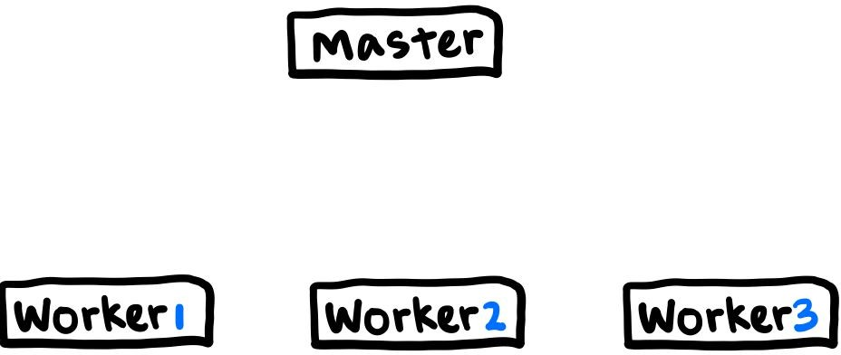
Structure
Structure
Single master
A set of workers

Slide 37
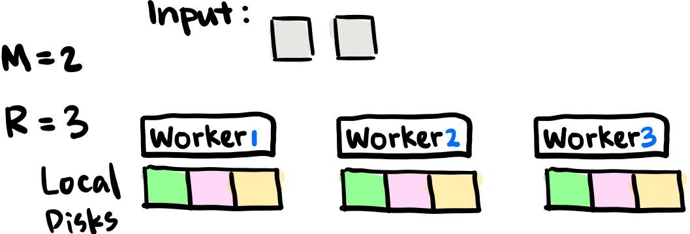
Structure
Execution
M: Partition input data into M splits
Typically 16-64 MB per piece
R: Partition intermediate key space into R pieces
Using a partitioning function
E.g. (hash(key) mod R)
All specified by user

Slide 38
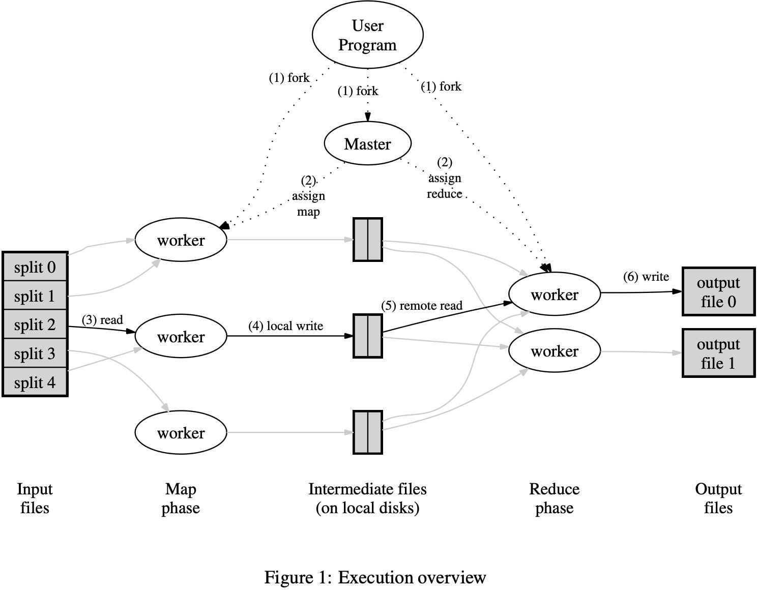
Execution
One master program
The rest are workers
Master assign map/reduce tasks to idle workers

Slide 39
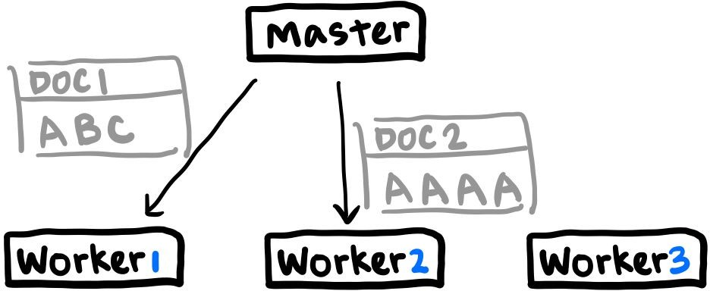
Execution Overview
Execution
One master program
The rest are workers
Master assign map/reduce tasks to idle workers

Slide 40
Execution Overview
Execution
Workers perform Map task
Intermediate key/value pairs buffered in memory
Periodically write buffered pairs into local disk
Locations of buffered pairs → Master

Slide 41
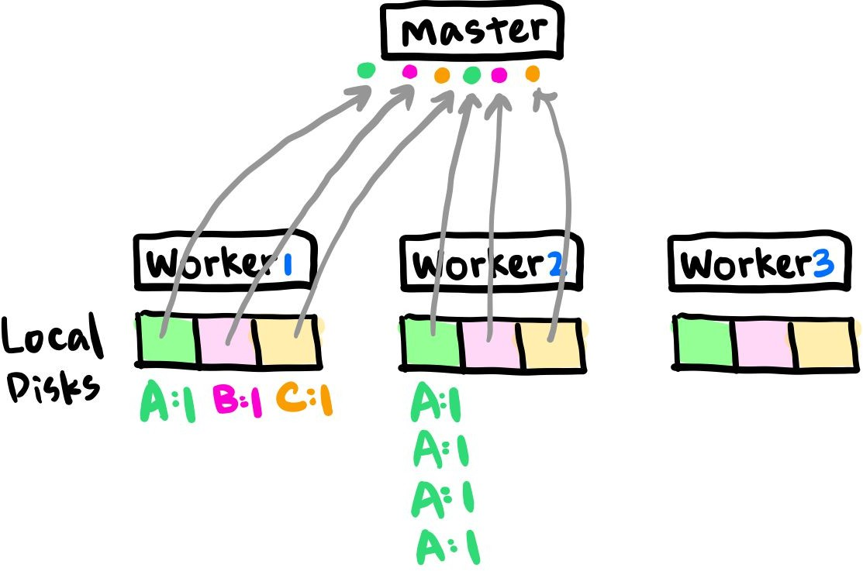
Execution Overview
Execution
Workers perform Map task
Intermediate key/value pairs buffered in memory
Periodically write buffered pairs into local disk
Locations of buffered pairs → Master

Slide 42
Execution Overview
Execution
Master sends these locations to reduce workers
Reduce worker reads intermediate data
Sorts data by intermediate keys →
Intermediates with same key group together
If intermediate data too large:
External sort is used
Atomically renames temporary output file → Final output file
Final file system: Data from one execution of each reduce task
Therefore, R output files

Slide 43
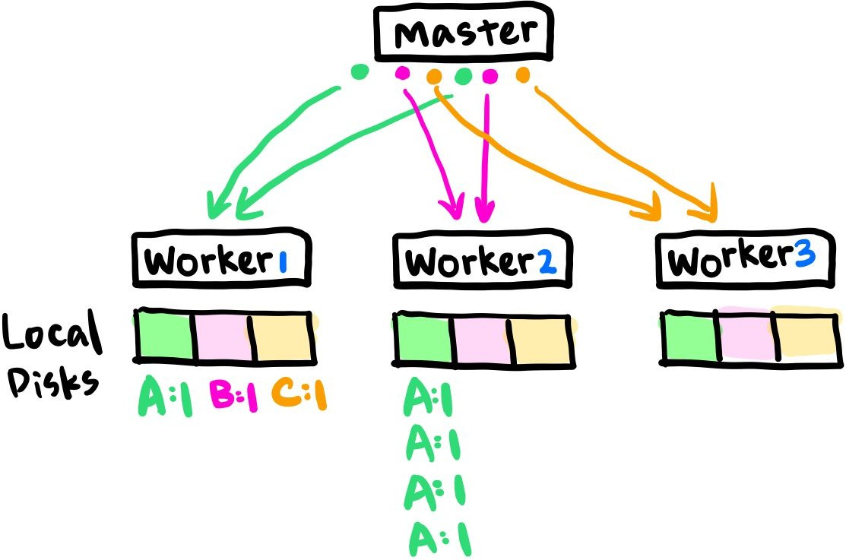
Execution Overview
Execution
Master sends these locations to reduce workers
Reduce worker reads intermediate data
Sorts data by intermediate keys →
Intermediates with same key group together
If intermediate data too large:
External sort is used

Slide 44
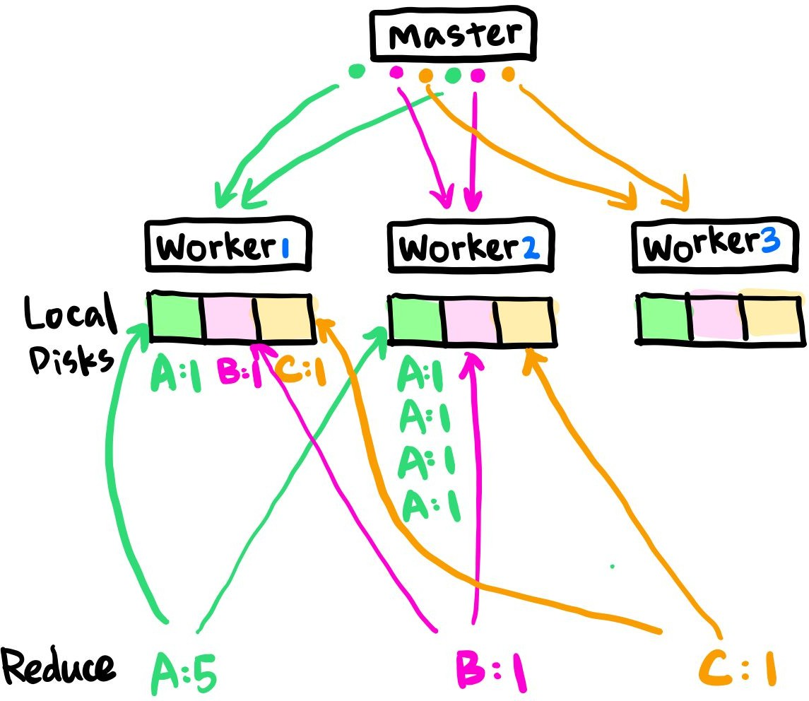
Execution Overview
Execution
Master sends these locations to reduce workers
Reduce worker reads intermediate data
Sorts by intermediate keys →
Intermediates with same key group together
If intermediate data too large:
External sort is used

Slide 45
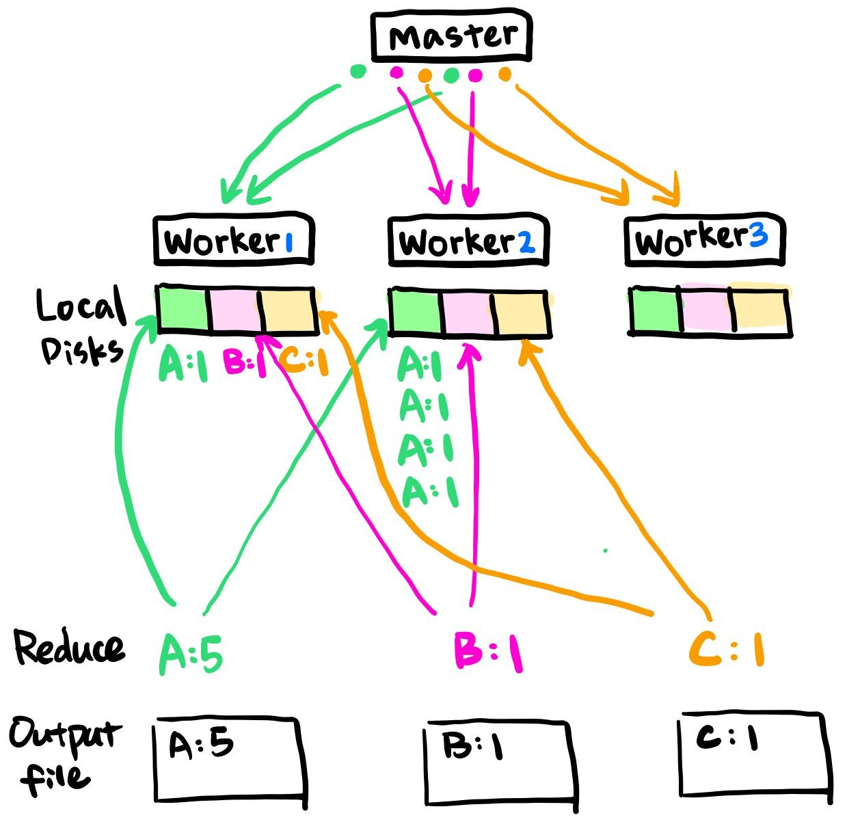
Execution Overview
Execution
Master sends these locations to reduce workers
Reduce worker reads intermediate data
Sorts by intermediate keys →
Intermediates with same key group together
If intermediate data too large:
External sort is used
Atomically renames temporary output file → Final output file
Final file system: Data from one execution of each reduce task
Therefore, R output files

Slide 46
Execution Overview
Execution
When all tasks completed
Master wakes up the user program

Slide 47
Execution Overview
Execution
Master data structures:
State of each map & reduce task:
Idle, in-progress, completed
Identity of worker machine
R intermediate file locations for each completed map task

Slide 48
Fault Tolerance
Fault Tolerance
Why important:
Commodity machines: Failures are common
Hundreds and thousands of machines: Tolerate faults gracefully
Primary mechanism: Re-execution
Worker Failure
Master Failure

Slide 49

Fault Tolerance
Fault Tolerance
Worker Failure
Master pings worker periodically
No response → Mark worker failed
Reset Map task completed by failed worker → idle state
Reset in-progress Map and Reduce tasks by failed worker → idle state
Idle tasks → eligible for rescheduling

Slide 50
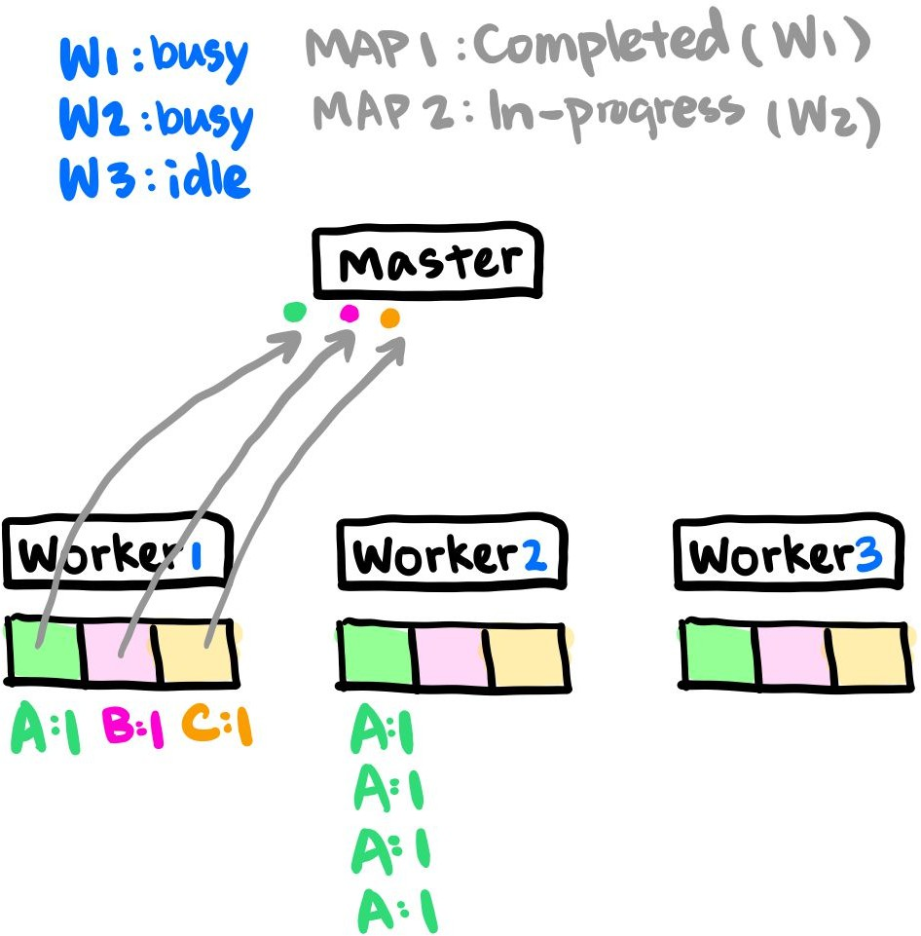
Fault Tolerance
Fault Tolerance
Worker Failure
Master pings worker periodically
No response → Mark worker failed
Reset Map task completed by failed worker → idle state
Reset in-progress Map and Reduce tasks by failed worker → idle state
Idle tasks → eligible for rescheduling

Slide 51
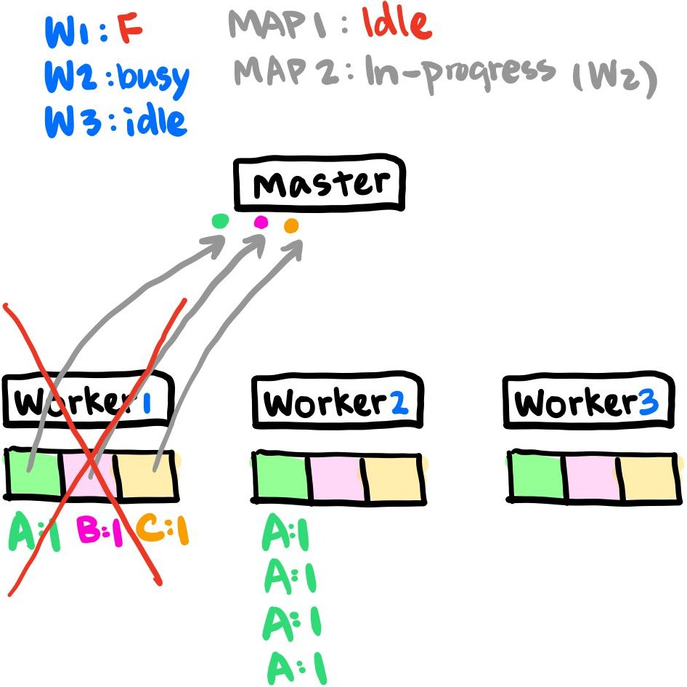
Fault Tolerance
Fault Tolerance
Worker Failure
Master pings worker periodically
No response → Mark worker failed
Reset Map task completed by failed worker → idle state
Reset in-progress Map and Reduce tasks → idle state
Idle tasks → eligible for rescheduling

Slide 52
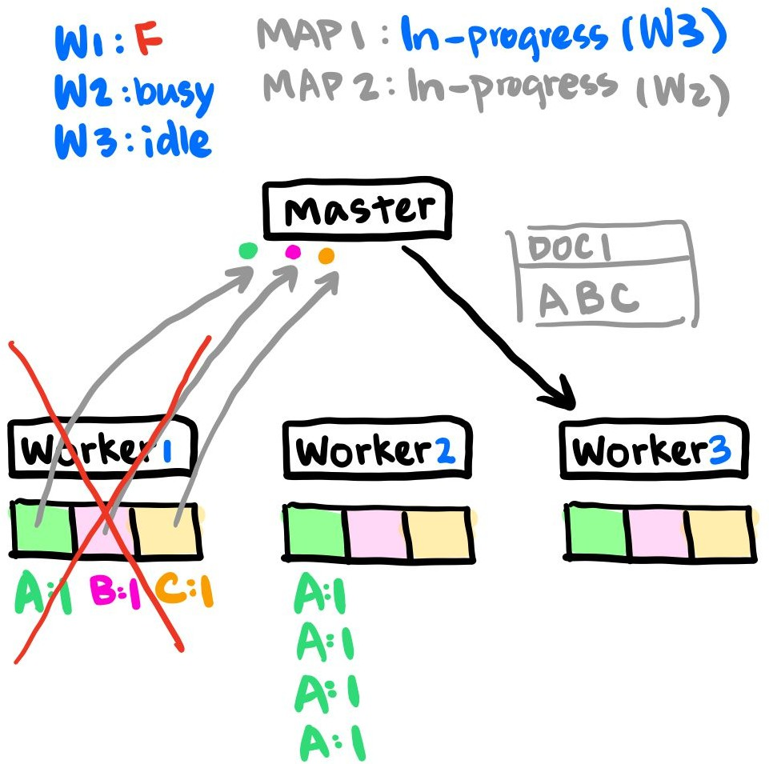
Fault Tolerance
Fault Tolerance
Worker Failure
Master pings worker periodically
No response → Mark worker failed
Reset Map task completed by failed worker → idle state
Reset in-progress Map and Reduce tasks → idle state
Idle tasks → eligible for rescheduling

Slide 53
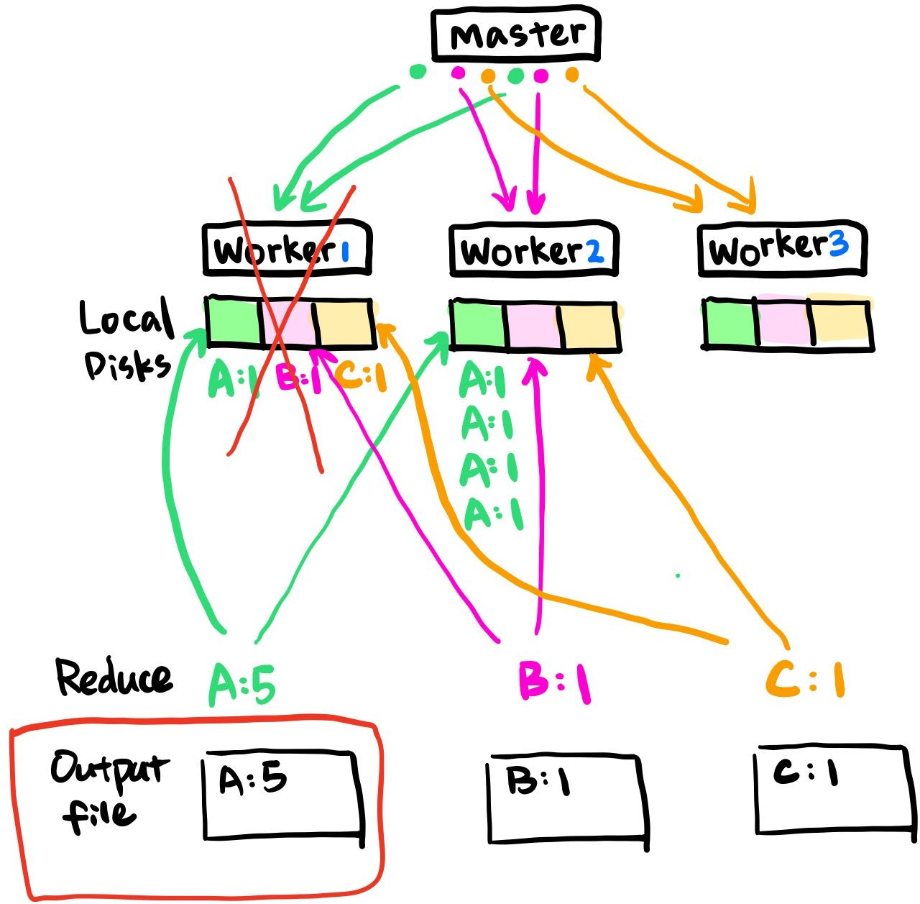
Fault Tolerance
Fault Tolerance
Worker Failure
Completed Map tasks are re-executed on failure
Map outputs: on local disks of workers
Completed Reduce tasks do not need
Reduce outputs: in global file system
All the workers will be notified of a re-execution
Reduce worker read data from new location
Resilient to large-scale worker failures

Slide 54
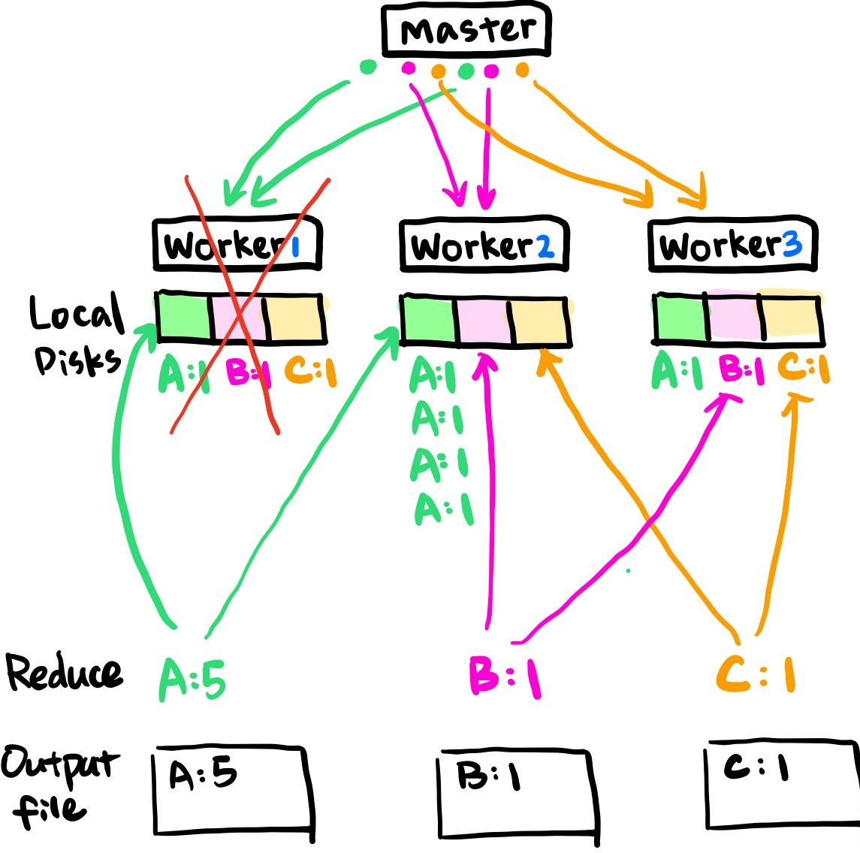
Fault Tolerance
Fault Tolerance
Worker Failure
Completed Map tasks are re-executed on failure
Map outputs: on local disks of workers
Completed Reduce tasks do not need
Reduce outputs: in global file system
All the workers will be notified of a re-execution
Reduce worker read data from new location
Resilient to large-scale worker failures

Slide 55

Fault Tolerance
Fault Tolerance
Master Failure
Single master, rare failure
If master fails, aborts the MapReduce computation
Client can retry

Slide 56
Outline
A bit about Distributed Systems
MapReduce Overview
MapReduce in Industry
Programming Hadoop MapReduce Jobs
Mappers and Reducers
Operating Model

Slide 57
Hadoop MapReduce
What it is: Specific implementation of a MapReduce system
What Hadoop MapReduce gives us:
A means of automatically distributing work across machines
Scheduling of jobs
Fault tolerance
Cluster monitoring and job tracking
How? An underlying resource manager (more on this later)

Slide 58
Hadoop MapReduce
How fast is it?
Benchmarks based on sorting large datasets (synthetic load)
Hadoop Record: 1.42TB / min
Record set in 2013 using a 2100 node cluster
Since 2014, Spark (and others) have been faster

Slide 59
MapReduce in Industry
Compelling Use Cases:
Batch Processing
Analyzing data “at rest” (i.e. daily/hourly jobs, not streaming data)
i.e. Log Processing, User data transformation / analysis, web scraping
Workloads that can be broken into a single (or few) distinct Map/Reduce phases
Poor results on iterative workloads
Non-parallizable workloads => Many MR stages => High bandwitdh overhead

Slide 60
MapReduce in Industry
Google
Released MapReduce whitepaper in 2004, detailing their use of MR to process large datasets
Inspired Hadoop MapReduce (Open source implementation)
Google later developed more advanced systems like Google Dataflow to improve on MapReduce's limitations.
Twitter
Uses MapReduce to “process tweets, log files, and many other types of data”

Slide 61
MapReduce in Industry
Facebook
Maintains 2 Hadoop clusters with 1400 total machines and 10,000+ processing cores, 15PB of storage
Spotify
Runs 20k+ Hadoop jobs daily
Uses Hadoop for “content generation, data aggregation, reporting, analysis”

Slide 62
MapReduce in Industry
LinkedIn
LinkedIn used Hadoop MapReduce for processing log data, building recommendation systems, and performing large-scale data analytics.
Netflix
Netflix used MapReduce to process viewing history, analyze user behavior, and generate personalized movie recommendations.
Amazon (AWS EMR)
Amazon provides a managed service called Amazon EMR (Elastic MapReduce) that allows companies to run MapReduce jobs for data processing, machine learning, and log analysis.

Slide 63

●
○
○
●
●

Slide 64
●
○
○
●
●

Slide 65

⇒ ⇒
●
○
○
●
○
○

Slide 66


●
○
■
●
○
■
○
■
■

Slide 67
●
○
○
○
num_posts.csv Alice;10 Bob;15
<Alice, (10, POSTS)>
<Bob, (15, POSTS)>
<Alice, (105, FRIENDS)>,
<Bob, (85, FRIENDS)>
Mapper
Reducer
<User, (Posts, Friends)>
<Alice, (10, 105)>
<Bob, (15, 85)>
num_friends.csv Alice;105 Bob;85

Slide 68

●
○
■
■

Slide 69
●
○
# Want to count number of unique values def reduce(self, key, values):
# 'unique' will store all distinct values we see unique = set()
for v in values:
if v not in unique: unique.add(v)
# yield size of unique value set
yield (key, len(unique))

Slide 70
●
○
■
■
○
■
■
■

Slide 71

●
○
# Want to count number of unique values
def reduce(self, key, values): prev, count = None, 0
# Here we assume that values is sorted
for v in values:
if v != prev:
count += 1
prev = v
yield (key, count)

Slide 72
●
○

Slide 73
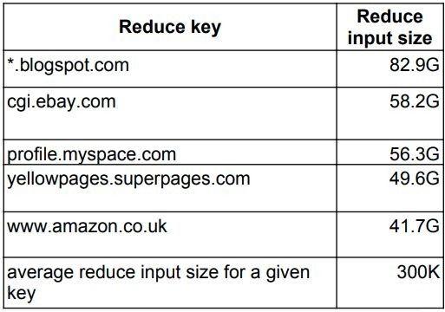
●
○
■
■
■
Source: https://research.google.com/pubs/pub36249.html

Slide 74
●
○
○
■
■
●
●
■

Slide 75


●
○
○
○

Slide 76

●
○
○
●
●

Slide 77

●
●
●

Slide 78

●
○
○
■
○
■
■
■

Slide 79

●
○
○
■
■
●
○
■
○

Slide 80
●
$ echo $DATA | ./mapper | sort -k1,1 | ./reducer > output
○
○

Slide 81

●
○
○
○
○
■
■
■
■

Slide 82
●
○
■
■

Slide 83
●
○
○
●
●

Slide 84

<... new york weather …>
<... illinois weather …>
<... kansas news …>
<... illinois news …>
Mapper
<””, ... illinois weather …>
<””, … illinois news …>
Reducer
<””, ... illinois weather …>
<””, … illinois news …>

Slide 85

<illinois.edu HTML>
<stanford.edu HTML>
<amazon.com HTML>
Mapper
<twitter.com, illinois.edu>
<twitter.com, stanford.edu>
<twitter.com, amazon.com>
...
Reducer
<twitter.com, (illinois.edu, stanford.edu, amazon.edu)>
...

Slide 86
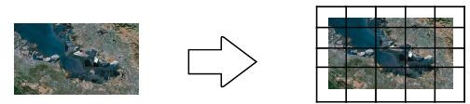

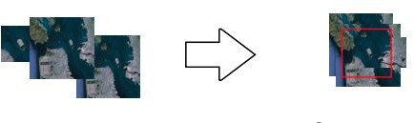
Source: https://research.google.com/pubs/pub36249.html

Slide 87






Slide 88



